Slide 1
Jokes Recommendation System
Shi Qian(Tea)-U1920856E
Jethro-U1921390C
Jia Hui-U1920794G
Notes:
Greetings
Intro T, AJP, JH
Jokes Recommendation System

Slide 2
1.
Introduction
Dataset and objective

Slide 3
Dataset
HTMLs and Ratings
Notes:
Jester Dataset

Slide 4
DATASET
HTML
100 files containing texts of jokes
CSVs
Three sheets containing ratings of jokes

Slide 5
JOKES
Being able to recommend people jokes that they will like

Slide 6
Objective
Explore and Analyse the Jokes
Classify the Users
Recommend Jokes

Slide 7
Exploring the Jokes
Semantic Analysis
Using words and phrases to determine the topic of a document
MSE = 3.3
Reading
Manually going through all of the jokes

Slide 8
Why Read?
1.
A joke is more than a collection of phrases
2.
Jokes are short

Slide 9
Why
Determine the topics of the jokes
Categorize the jokes
Figure out preferences of each cluster

Slide 10
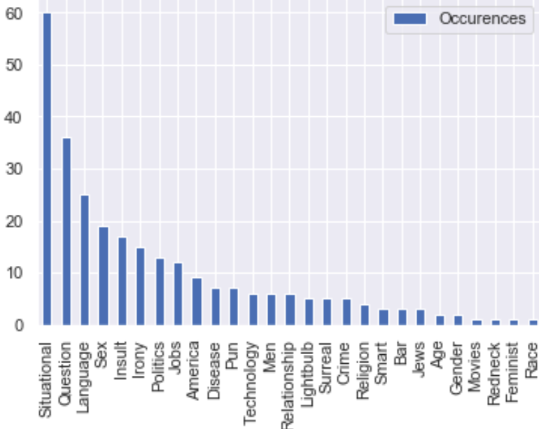
A PICTURE
The bar chart shows the occurrences of each tags for the 100 jokes

Slide 11
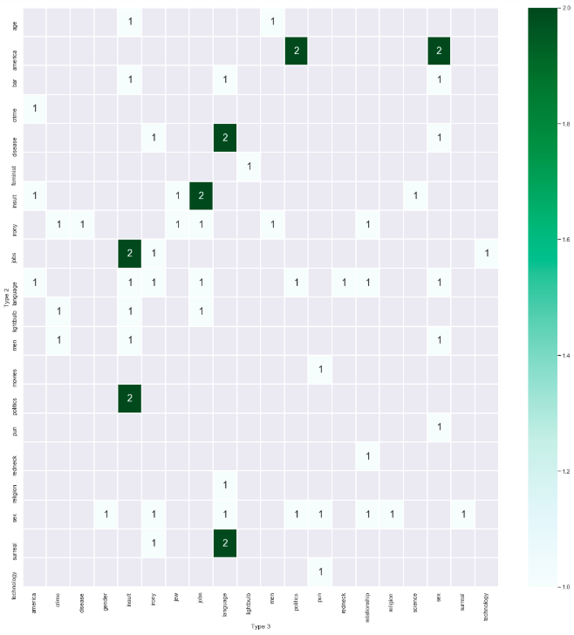
A PICTURE
The heat map shown the occurrences of tags that appear with each other

Slide 12
2.
Data Preparation
Filling in missing values

Slide 13
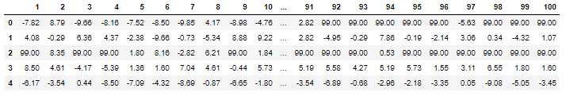
The Data
Jokes
Users
Jokes are rated from -10.00 to 10.00
There are lots of missing values
Notes:
A sparse matrix isn’t good to perform ML on, so we have to fill in the missing values.

Slide 14
Fill in with?
“What the user would rate the . joke if they had seen it” .
Global average
The avg of all valid scores of all jokes from every user.
User Bias
For each user, the avg score users give.
to avoid double counting biases
Joke Bias
For each joke, the avg score users give the joke.
joke bias + user bias
Fill in = global avg +
2

Slide 15
3.
Clustering
Models used and results

Slide 16
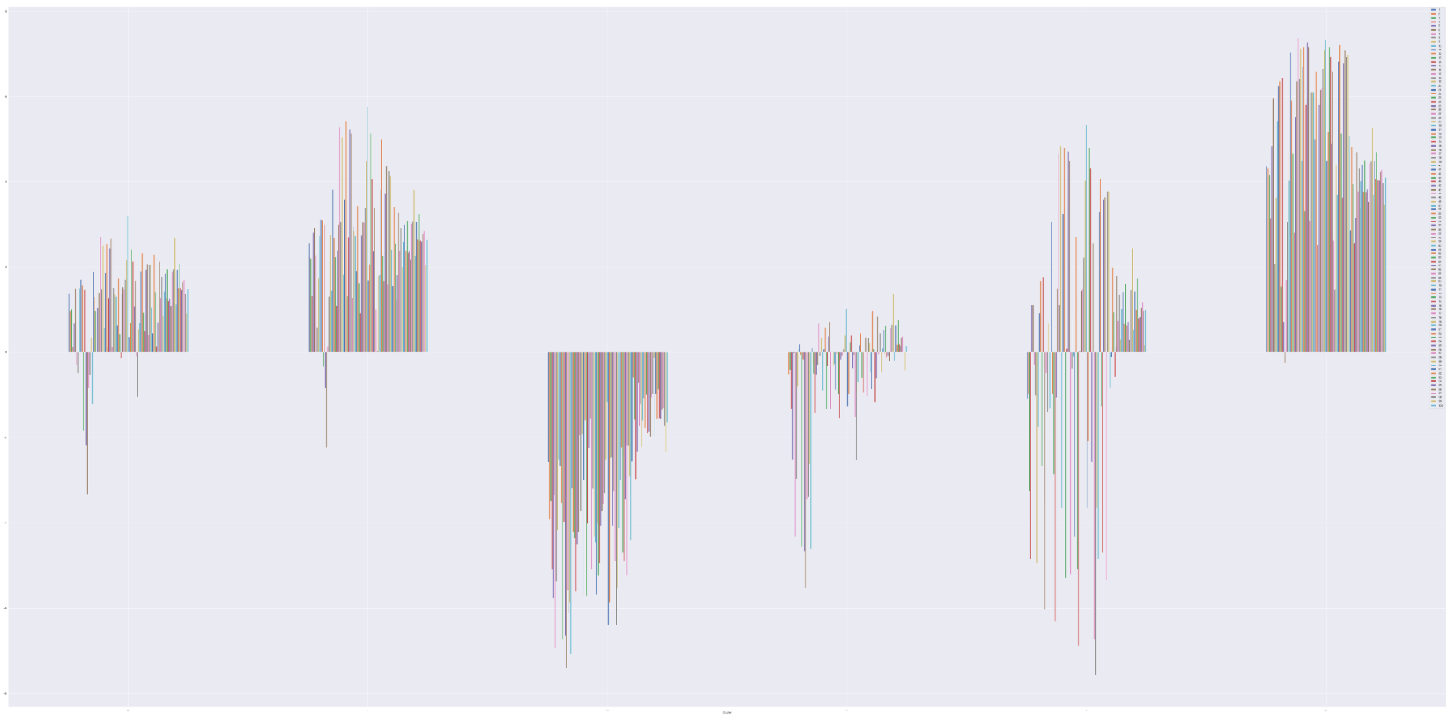
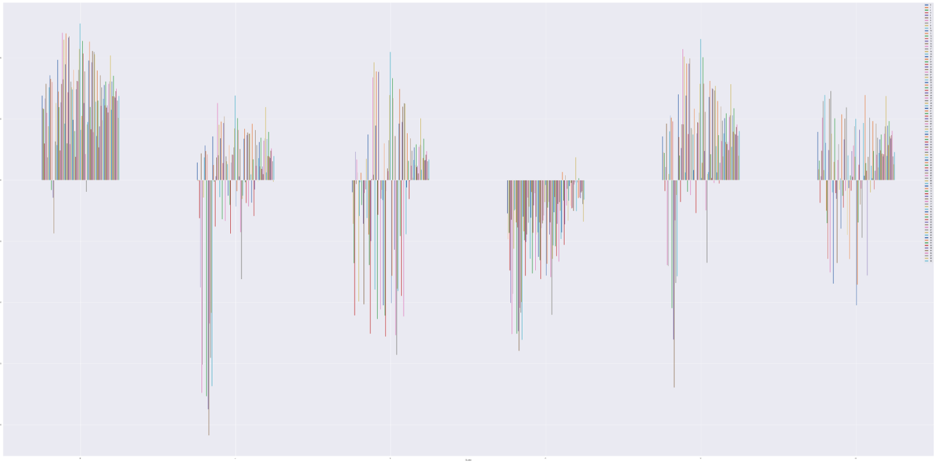
K-means
Euclidean vs. Cosine
Cosine produces more meaningful results.
Notes:
Comparing these 6 clusters to the 6 clusters created using euclidean distance, we see that these clusters show more meaningful characteristics. This can be seen by the many negative and positive ratings of different jokes in the same group, which indicate clear preferences.

Slide 17
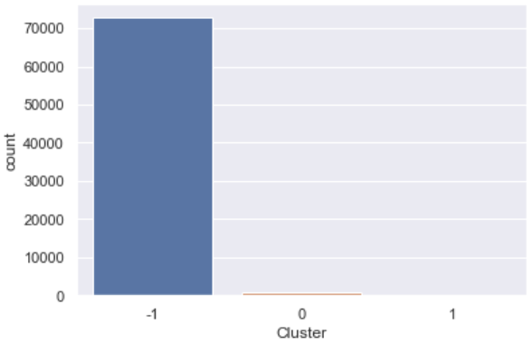
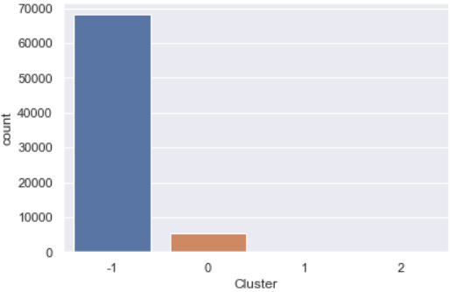
DBScan
Many iterations (~20) of dbscan were run with different parameters.
These were the best results:
Cluster -1 are anomalies
Notes:
All iterations produced unusable results.

Slide 18
Hierarchical Clustering
Takes too much time and power to compute.
Unable to attempt.

Slide 19
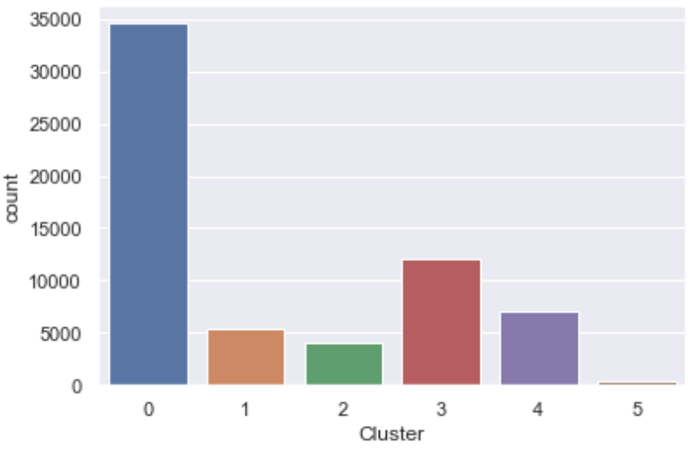
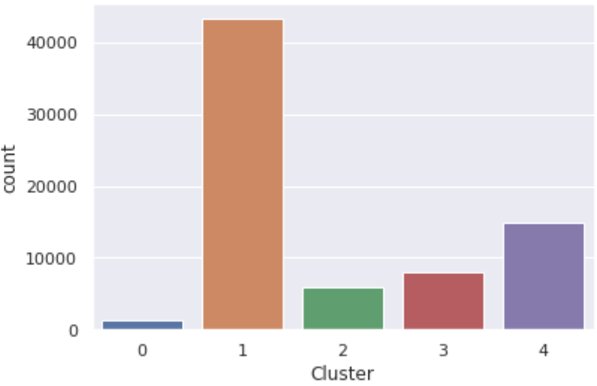
Therefore we use K-means (cosine)
6 clusters vs. 5 clusters
Having 6 clusters results in one tiny cluster, so 5 clusters are used instead.

Slide 20
4.
Cluster Preferences
Exploring cluster characteristics

Slide 21
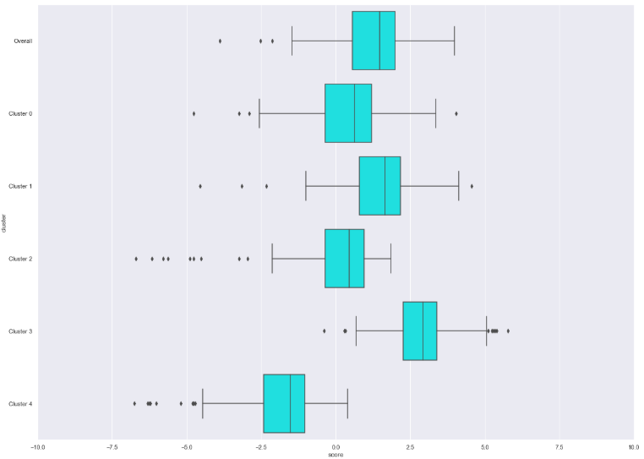
Overall Behaviour
Cluster
Behaviour
0
Most neutral cluster
1
Slight positive bias
High min ratings
2
Highest std dev
Stronger preferences
3
Strong positive bias
The “happiest” cluster
4
Strong negative bias
Few positively rated jokes

Slide 22
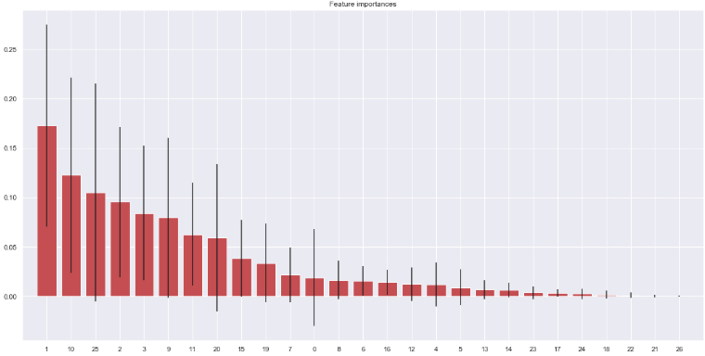
Random Forest Regression
For each cluster, perform random forest regression:
X = joke tags
y = joke scores
Then we extract the feature importances.
Feature Importances

Slide 23
Explore some of the most important features
Joke types | Language | Pun | Sex
More prefered by clusters: | 1, 2, 3 | 3, 4 | 1, 2, 3
Less prefered by clusters: | 0, 4 | 0, 1, 2 | 0, 4

Slide 24
5.
Application
Creating the Jokes Recommendation System

Slide 25
Focus:
Recommendation favourite jokes
Target audience will be new users
Note that new users must rate some jokes before we can recommend them any

Slide 26
Steps to create recommendation system:
Step 1:
Classify new users into the user cluster
Step 2:
Predict the most popular jokes they will like according to their cluster

Slide 27

Step 1: Classify users
Recall that:
We have 5 user clusters from our kmeans ML model
To classify new users:
New user allocated to closest centroid:
Distance can be calculated by euclidean or cosine (Euclidean worked better)

Slide 28
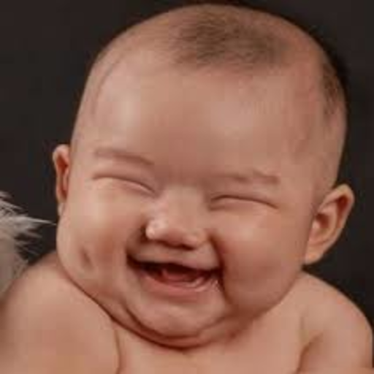
Step 2: Predict Jokes
Recall that:
We have assigned users to their cluster
To recommend jokes:
Predict rating of new jokes by new user
Make sure they DID NOT read them before
Select highest 10 (funniest 10)

Slide 29
6.
Validation
Discussing accuracy of ML and effectiveness of recommendation

Slide 30
Effectiveness is dependent on:
1) Accuracy of cluster in predicting joke ratings
2) Accuracy of clustering user in correct cluster

Slide 31
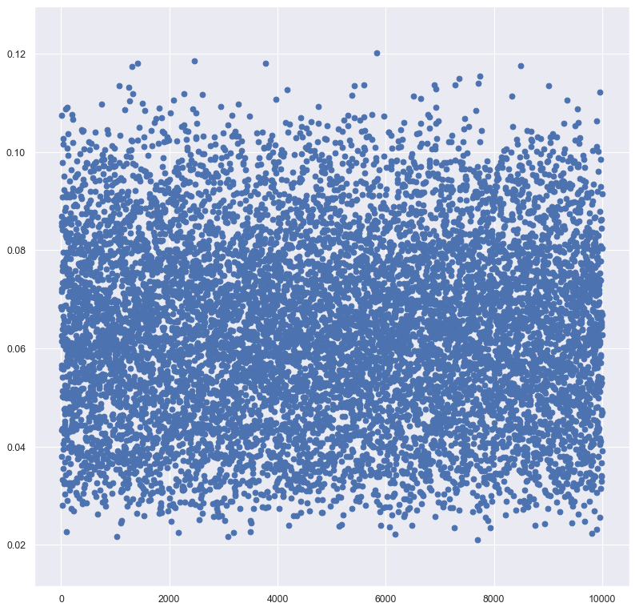
Accuracy of cluster in predicting joke ratings
Comparing the distance between predicted scores and real scores
Compare standard deviation before cluster creation and after cluster creation

Slide 32
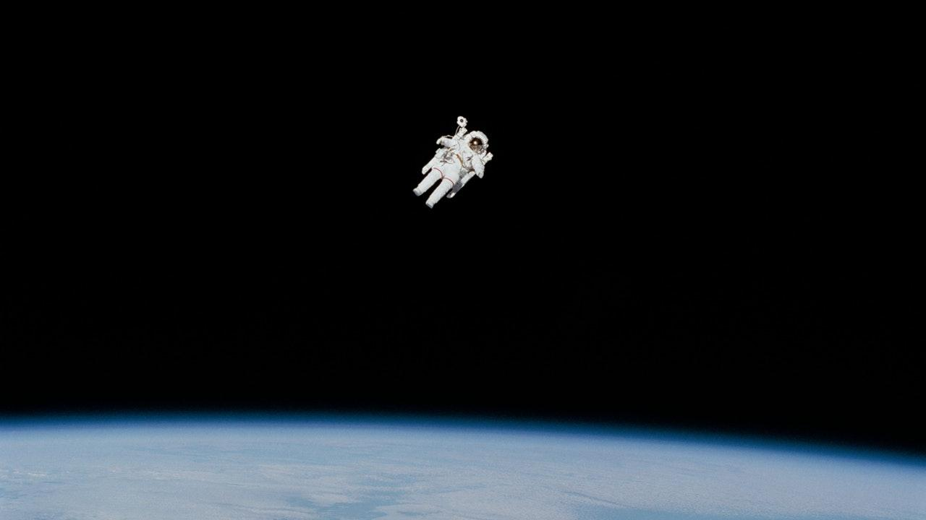
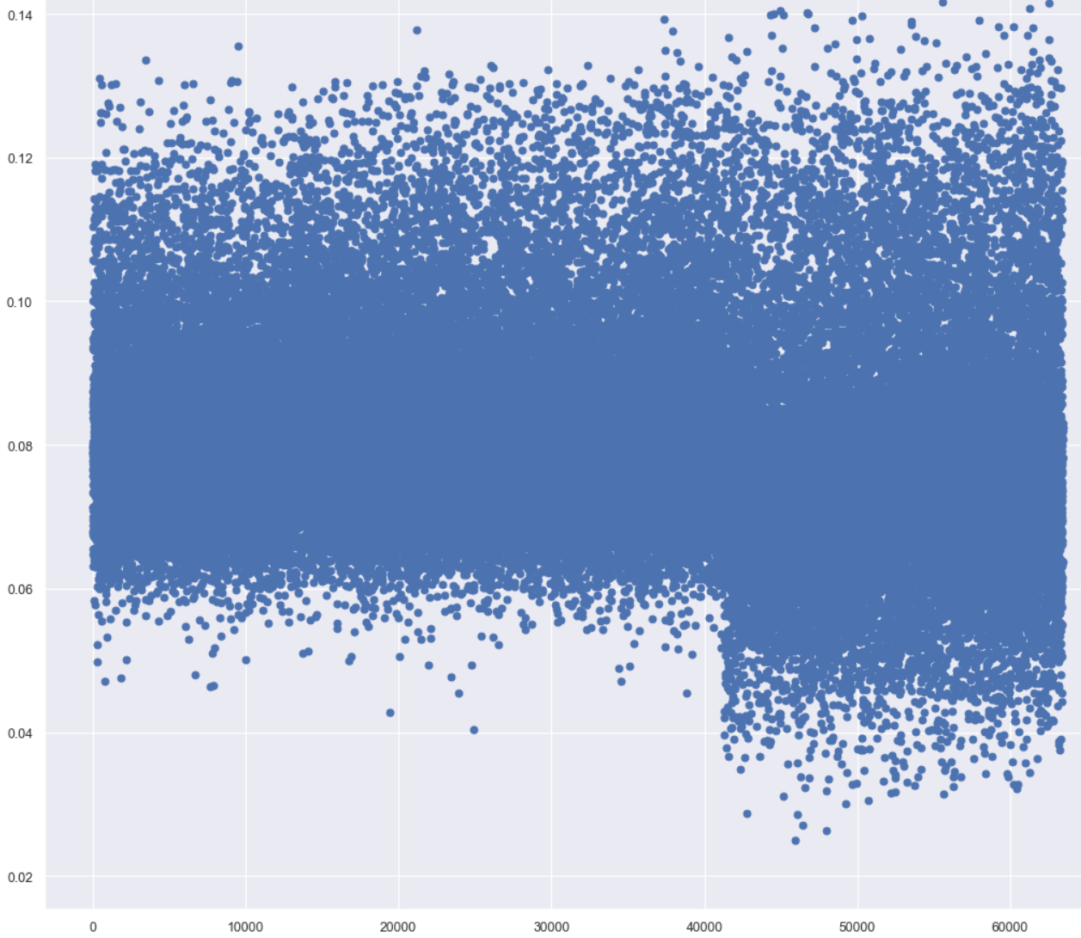
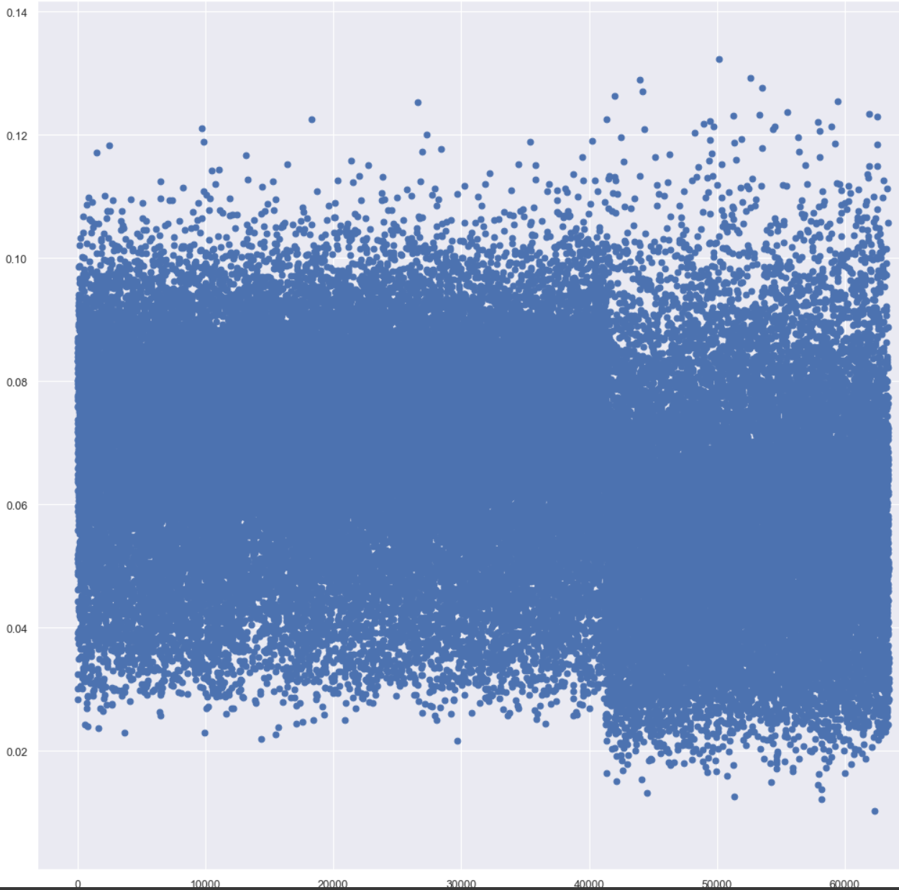
un-clustered data
Predicted vs real score distance
clustered data
Predicted vs real score distance

Slide 33
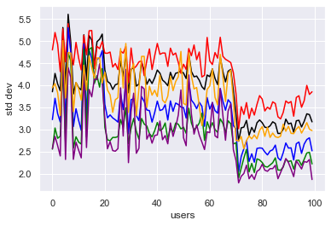
STD DEV
Black-Without clusters
Coloured-the 5 clusters

Slide 34






Accuracy of clustering user in correct cluster
Compared to ML of re-clustering of all data (original jester data and new user data)
V-measure score

Slide 35
95++%
83-84%
100%
Euclidean distance
Cosine distance
Consistency for all runs

Slide 36
86++%
V-measure score of Euclidean(higher=better)
*V-measure score of Cosine is 82~%

Slide 37
Validation logic:
Joke Recommendations system made: predict scores based on user cluster
1
Accuracy of clustering users to correct clusters: Euclidean preferred; 95% accuracy
2
Accuracy of cluster in predicting joke ratings:
Necessitates clustering.
3

Slide 38
Parts assignment:
Name:
Shi Qian(Tea) | Clustering accuracy in prediction | Testing classification methods and classifying new users | Creating Joke Recommendation System
Jethro | Latent Semantic Analysis | Joke tagging | Joke Exploration
Jia Hui | Preprocessing data | Clustering Users | Exploring Clusters

Slide 39
P.S. Funny changes with the era!
Any Questions?

